Slide 1
Introduction to SFTP & PGP Encryption
Reliable data.
Informed decisions.
Strategic advantage.

Slide 2
Welcome & Introductions
Gina Robertson, Data Operations Manager
Jacob Kemer, Cloud Support Engineer
Grace Chandler, Project Manager for the IN-APCD

Slide 3
Agenda
Overview of two options for submitting files to the APCD
Manual upload within the data collection portal
File transfer via Secure File Transfer Protocol (SFTP)
Demonstrations of PGP encryption and SFTP access
Review frequently asked questions surrounding SFTP and PGP encryption
Next steps, resources, and support to establish connectivity with Onpoint
Questions?
Implementation timeline reminders

Slide 4
Overview of Two Options for Submitting Files to the IN-APCD
Gina Robertson, Data Operations Manager

Slide 5
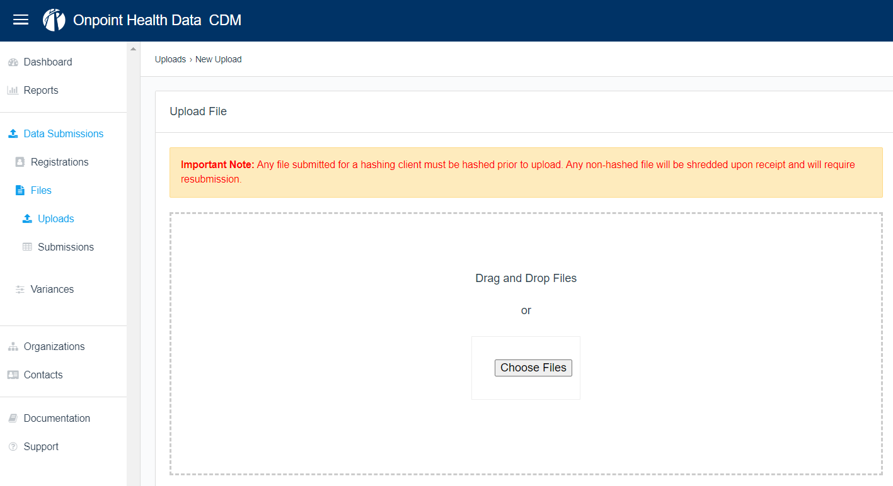
Option #1: Upload Files Manually within the Portal

Slide 6
Option #2: Submit Files via SFTP
Secure File Transfer Protocol (SFTP)
Allows file transmissions between a client and host system through an encrypted channel

Slide 7
Required for Both Options: PGP Encryption
Allows for secure exchanges of data between two parties using a public and private key pair to encrypt sensitive data
Generate raw
file
Sign with Data Supplier’s private key
Encrypt with Onpoint’s public key
Signed & encrypted
file
SFTP
with
PGP
PR
PU
Data Supplier
Onpoint

Slide 8
PGP Encryption & SFTP: The Basics
Onpoint uses PGP encryption to protect files (at rest) and confirm the sender
As part of PGP encryption and SFTP data transfer, submitters will generate two sets of key pairs:
A PGP key pair, used for encrypting your data
An SSH (Secure Shell) key pair, used for SFTP account authentication
Both PGP and SSH key pairs have a public and a private key
Private keys should never be shared and should be backed up
Public keys are transferable and will be shared with Onpoint
Different organizations have different security requirements; contact your IT team to confirm your organization’s firewall access

Slide 9
Demonstration of PGP Encryption & SFTP Access
Jacob Kemer, Cloud Support Engineer

Slide 10
Demonstrations
Demonstration #1: PGP encryption
PGP key generation
File encryption
Demonstration #2: SFTP access
SSH key generation
Log-in to SFTP account
File transfer via SFTP

Slide 11
Demonstration #1: PGP Encryption
Jacob Kemer, Cloud Support Engineer

Slide 12
Demonstration #2: SFTP Access
Jacob Kemer, Cloud Support Engineer

Slide 13
SFTP & PGP Encryption
Frequently Asked Questions (FAQs)
Gina Robertson, Data Operations Manager

Slide 14
FAQs: Submitting via SFTP & PGP Encryption
"Why do I still see my submission in my SFTP account after file transfer?"
Files “live” within your SFTP account for 30 days but can be deleted or resubmitted at your discretion
After 30 days, files are archived locally for 150 days within your SFTP account but cannot be updated or deleted without permission from Onpoint’s IT department
To update or delete visibly archived files, please send your request to: in-support@onpointhealthdata.org
"How do I know whether my file transferred successfully?"
SFTP submission and file progress are traceable in the data collection portal
Automatic emails will inform your team if a file fails during the transmission process

Slide 15
FAQs: Submitting via SFTP & PGP Encryption (cont.)
"If our team submits data to Onpoint for another state’s APCD, can we use the same SFTP account to transfer data for the IN-APCD?"
No; Onpoint requires distinct SFTP accounts for each state APCD to ensure each state’s dataset is maintained separately and securely
Submitters can use the same PGP and SSH keypairs for their IN-APCD SFTP account as those used for another state’s SFTP account; if your team chooses to use the same PGP and SSH keypair for the IN-APCD as another state’s APCD, please include this information in your request for SFTP set-up to Onpoint
"Do we have to encrypt the files if we are using SFTP?"
Yes; PGP encryption is required when submitting data to the IN-APCD through both SFTP and manual upload within the data collection portal

Slide 16
FAQs: Submitting via SFTP & PGP Encryption (cont.)
“Can we submit data through both SFTP and manual upload within the data collection portal?"
Both manual upload and SFTP file submissions are acceptable, however, Onpoint recommends selecting a single method for all submissions to avoid confusion and potential duplicate submissions.
"When uploading files within Onpoint’s Claims Data Manager (CDM) for other states, there is a dropdown for submitters to select the state for which their team is uploading a file. Will this same dropdown be available for the IN-APCD, or will the IN-APCD require a separate log-in to CDM?"
Onpoint CDM will have a dropdown where you will select IN for submission of the IN-APCD files; no separate CDM log-in will be required.

Slide 17
Next Steps, Resources, & Support
Gina Robertson, Data Operations Manager

Slide 18
Next Steps for Establishing SFTP Connectivity
Onpoint has created a user guide for PGP set-up and SFTP connectivity that details all aspects of the process, including…
Step-by-step directions regarding PGP and SSH key generation
An overview of establishing SFTP connectivity with Onpoint
Guidelines for file signing, encryption, and decryption
Onpoint will send a follow-up email with SFTP registration form and user guide
Communicate with your IT department to coordinate SFTP connectivity efforts
Please note: While submitters are encouraged to prepare PGP and SSH key pairs and initiate internal requests for PGP encryption and SFTP connectivity, Onpoint cannot complete SFTP requests until the submitter’s registration is complete.

Slide 19
Questions?
Technical questions:
in-support@onpointhealthdata.org
Regulatory questions:
apcd@idoi.in.gov

Slide 20
Implementation & Training Timeline Reminders
Gina Robertson, Data Operations Manager

Slide 21
Implementation & Training Timeline
Date | Details
3/22/2023 | Webinar: Training on APCD implementation, the APCD-CDL™, and submitter registration
3/24/2023 | Submitter registration opens for IN-APCD data submitters
3/29/2023 | Webinar: Training on PGP encryption and the SFTP submission process
4/5/2023 | Onpoint CDM opens for registered IN-APCD data submitters
4/11/2023 | Webinar: Training on Onpoint CDM and data variances
4/25/2023 | Webinar: Overview of Onpoint CDM and data submission best practices
4/28/2023 | Submitter registration due for the IN-APCD
6/30/2023 | Successful submission of encrypted test file due via Onpoint CDM
Ongoing | One-on-one submitter support meetings

Slide 22
Thank you.

