Slide 1
An Experiential “Look” at Streets and Spaces: ADA from a Blind Pedestrian’s Perspective
Christopher Meyer

Slide 2
Personal Bio
Christopher Meyer is a senior Public Affairs student at the IU School of Public and Environmental Affairs (SPEA) in Indianapolis. He pursues high academic achievement and conducts graduate research with the Human-Computer Interactions team at IUPUI’s School of Informatics and Computing. His focus area centers on innovating new ways that smart technologies can enhance the lives of the blind and visually impaired.
Christopher is passionate about empowering blind and visually impaired people like himself to become more mobile and independent. He uses 3-dimensional printing to design and build custom tactile aids to be used by the blind and visually impaired to confidently navigate public spaces.

Slide 3
Interesting Facts
Early childhood outside of the United States and a one-year Fellowship abroad
German fluency and tri-citizenship
Avid runner, swimmer, and traveler
Constant crave of Indian Food
… And legally blind since birth

Slide 4
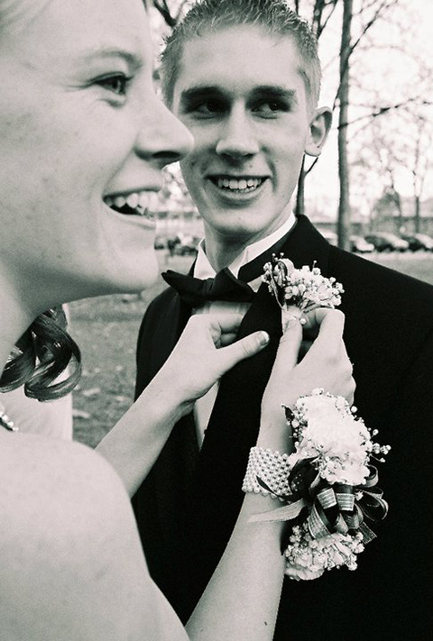
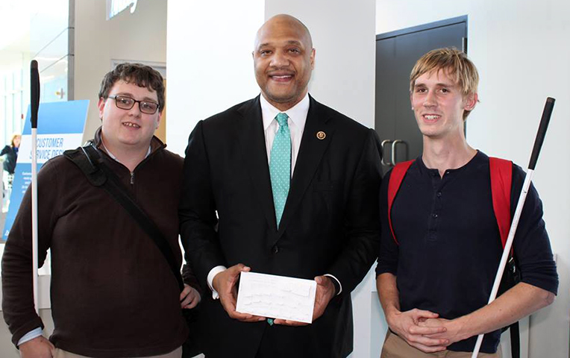

Slide 5
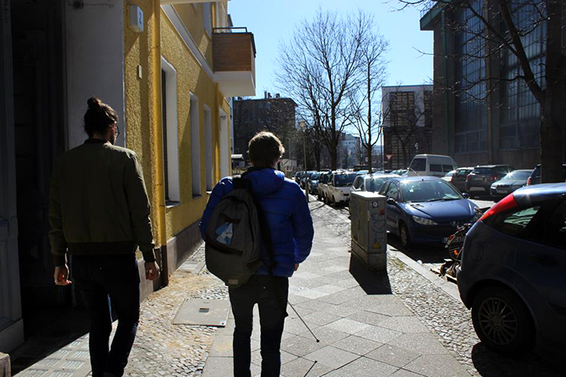
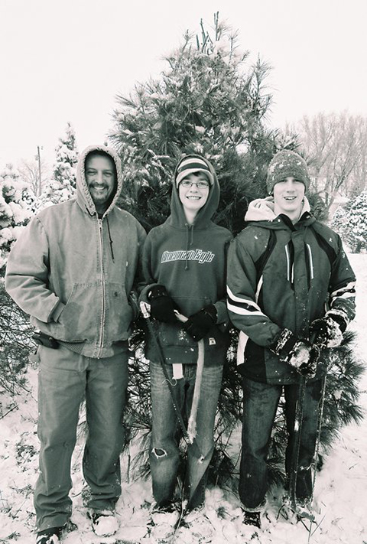
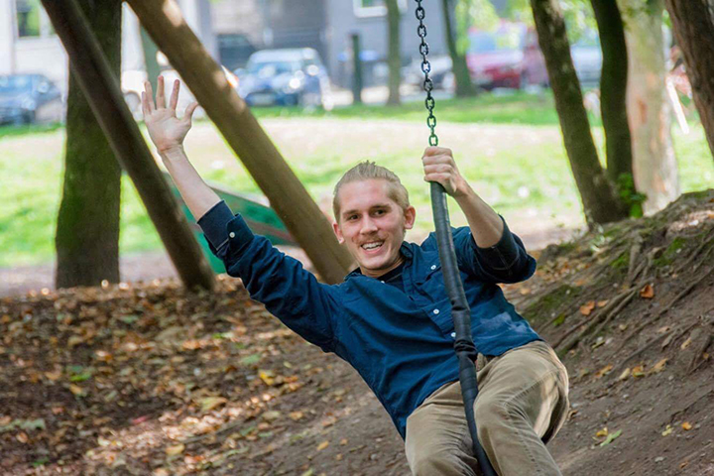
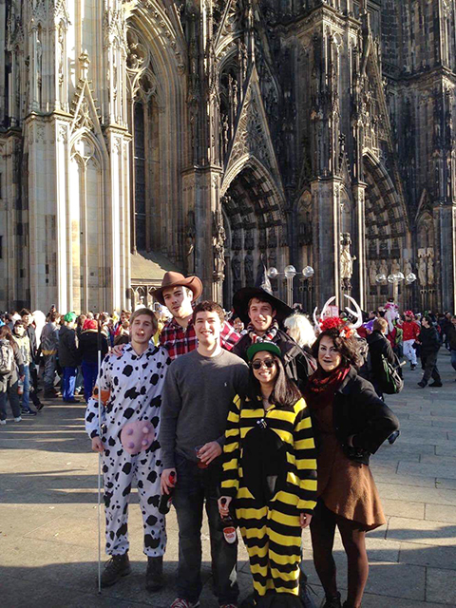

Slide 6
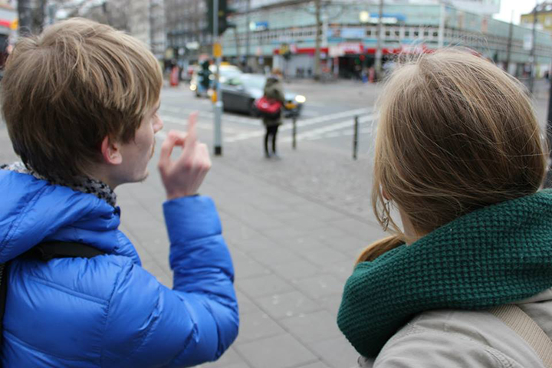
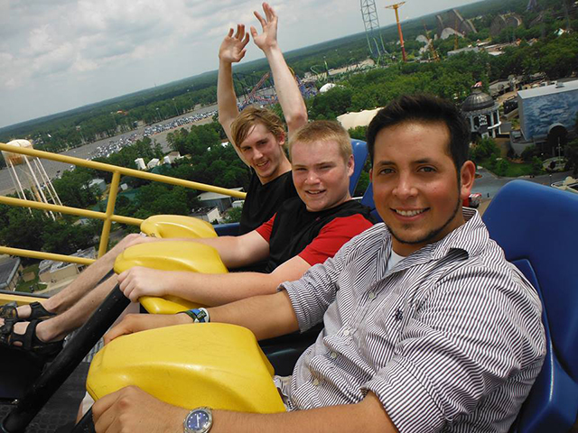
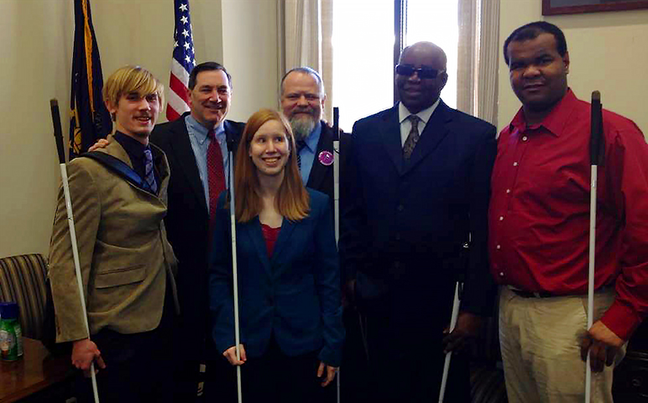

Slide 7
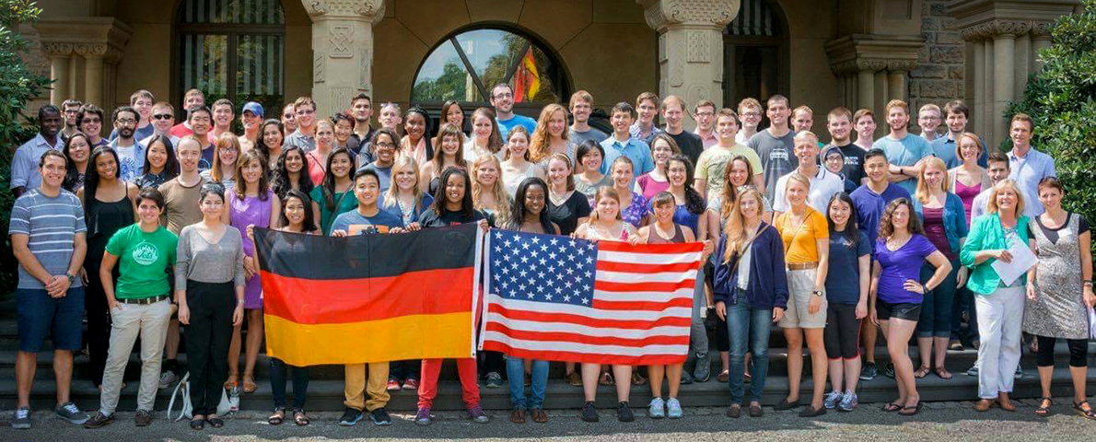
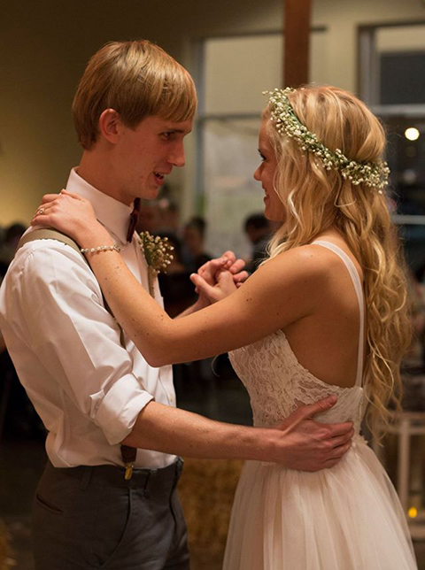
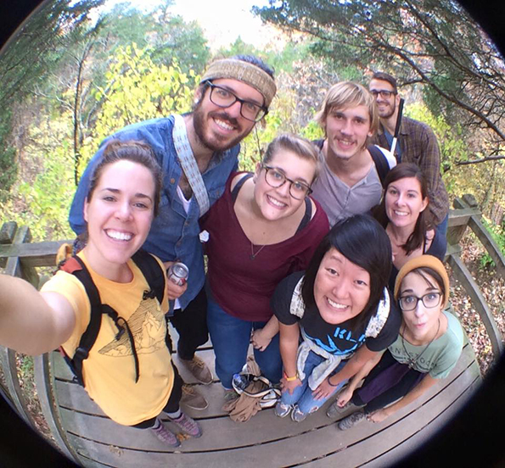

Slide 8
Talking Blindness: Different Terms, Different Sensibilities
Say-What! Blind? V.I.? Low Vision?... “Ocularly occluded”?
What blindness means to me: accepting, adapting, accommodating, aspiring
Being blind does not mean a person cannot navigate the world independently. Barriers that disconnect the blind from every day life should be reduced, and remove the concept of limited abilities.
Broadening the Horizon of Blindness
Through public awareness, technology and training
Different Philosophies in Blind Schools, Employment Rehabilitation

Slide 9
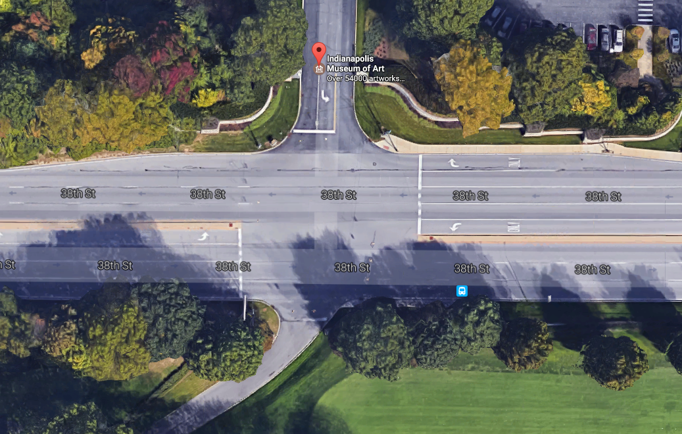
Non-Audible, On-Demand Pedestrian Crossings
Push buttons not audible, yet pedestrian cycle only on-demand
How to know you have to push a button?
Where are other pedestrians?
Eight lane span of roadway
38th & Private Drive

Slide 10
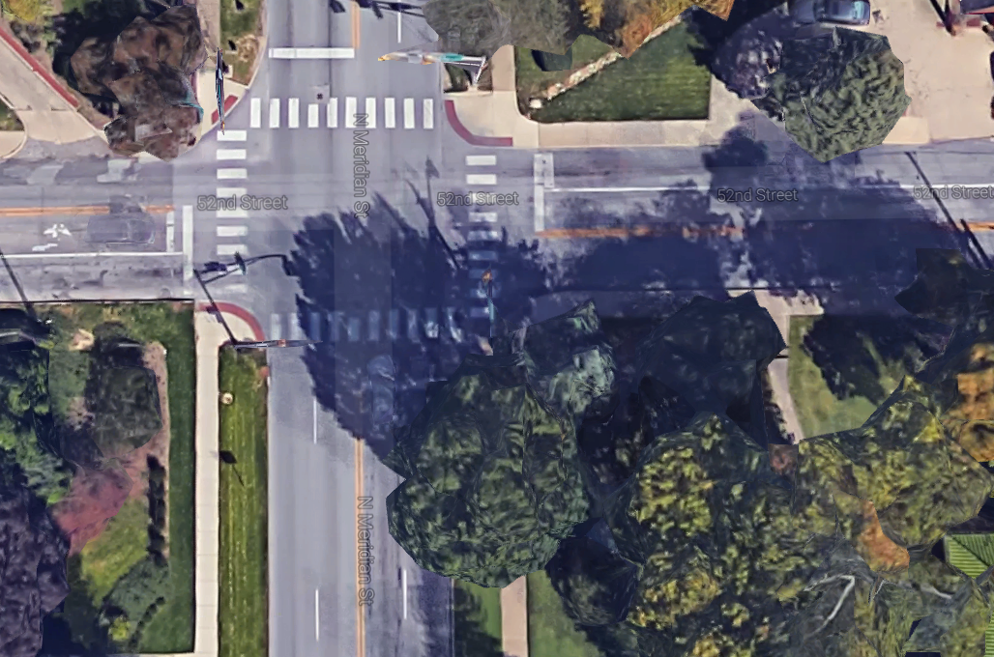
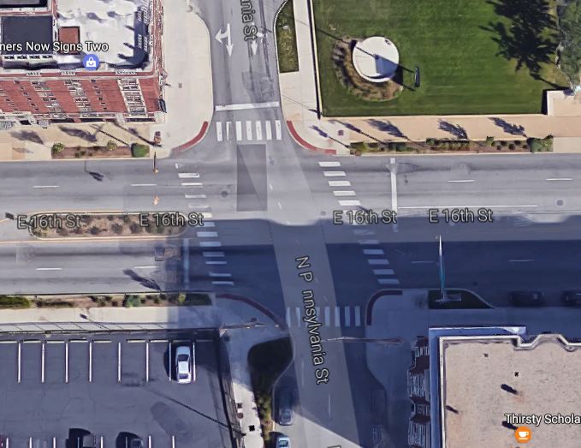
Non-Audible, On-Demand Pedestrian Crossings
Unusual traffic patterns = hard to predict
Priority given to vehicles should prompt APS
Longer cross cycle
Two examples of a-typical traffic patterns
52nd St. & Meridian
16th & Pennsylvania

Slide 11
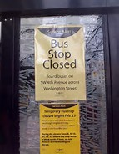
(NO) WARNING! Construction Zones Ahead
Sidewalk closure apparent too late
Notify pedestrians in advance
Bus shelter closures, no notice
Meridian and 10th St.

Slide 12
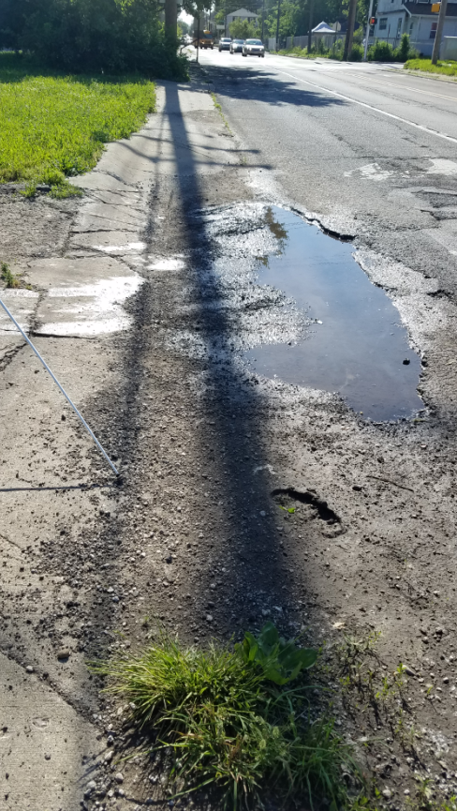
Hazards -- Poor Maintenance of Sidewalks
Cost of repairing sidewalks challenges budgetary constraints
NOT repairing sidewalks makes pedestrian travel difficult, especially for persons with disabilities
What are some potential solutions?
29th street East of Central, also a temporary bus stop

Slide 13
Recommendations: Community Involvement
Contact the local chapter and state affiliate of consumer advocacy groups (ACB, NFB, Lighthouse)
Ask for invitation to local chapter meetings to hear concerns
Attend short-term adjustment-to-blindness training to learn how blind people live every day lives
Seat blind advocates on committees to improve accommodations and avoid potential complaints in matters of public services
Connect with orientation and mobility professionals
Distribute announcements of concern on NFB NewsLine

Slide 14
Contact Info – Consumer Advocacy Groups
ACB of Indiana
Lynn Powers, President
Indianapolis, IN
317-368-3765
powlynn@gmail.com
Website: http://www.acb-indiana.org/3/gallery.htm
NFB of Indiana
Ron Brown, President
6010 Winnpeny Lane
Indianapolis, Indiana 46220-5253
317-205-9226
Email: rb15@iquest.net
Website: http://www.nfb-in.org

Slide 15
Contact Info -- Rehabilitation Training Centers
BLIND, Incorporated (Blindness: Learning in New Dimensions, Incorporated)
Dan Wenzel, Executive Director
100 East 22nd Street South
Minneapolis, Minnesota 55404
Phone: 612-872-0100
Toll Free: 800-597-9558
Fax: 612-872-9358
Email: info@blindinc.org
Website: http://www.blindinc.org/
Bosma Enterprises
6270 Corporate Drive
Indianapolis, Indiana 46278
317-684-0600 (local)
866-602-6762 (toll free)

